Slide 1



Data set insights presentation
Company name
View in Power BI
Last data refresh:
6/5/2022 6:48:55 AM UTC
Downloaded at:
6/5/2022 7:11:54 AM UTC

Slide 2
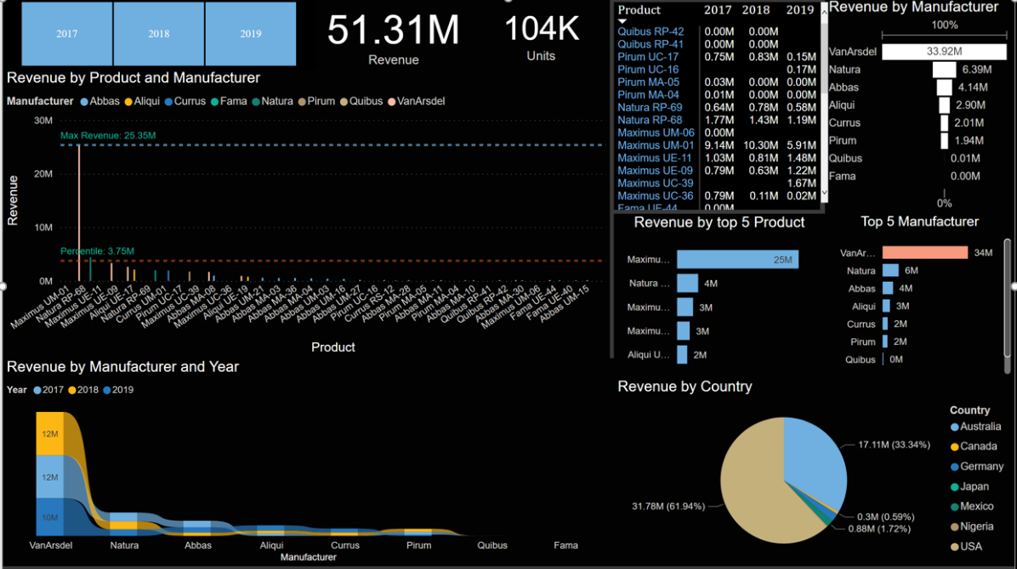
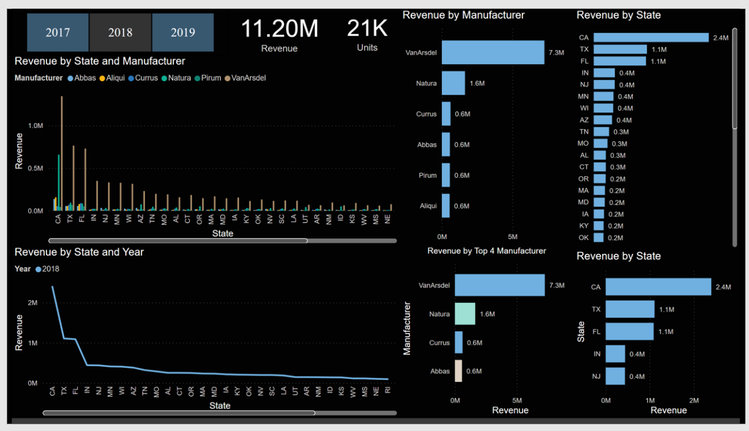
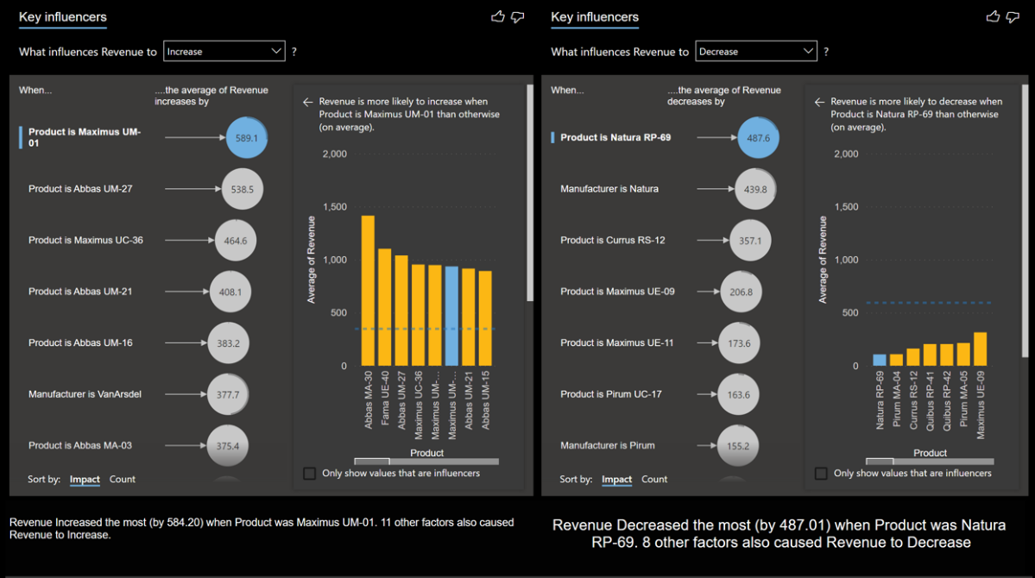
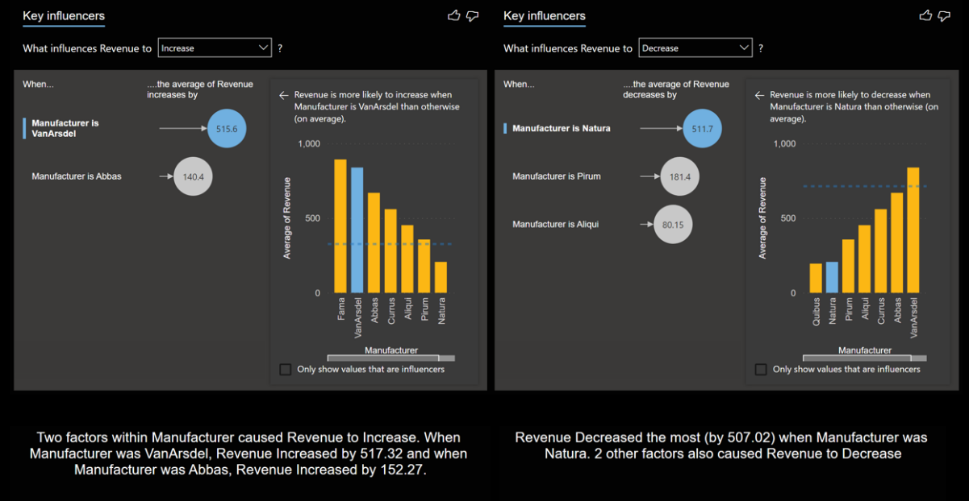
Outline
Revenue details of the company
Summary of company revenue details
Key influences of revenue
Revenue details of country (USA)
Summary of revenue details USA
Key influences of company revenue in USA

Slide 3
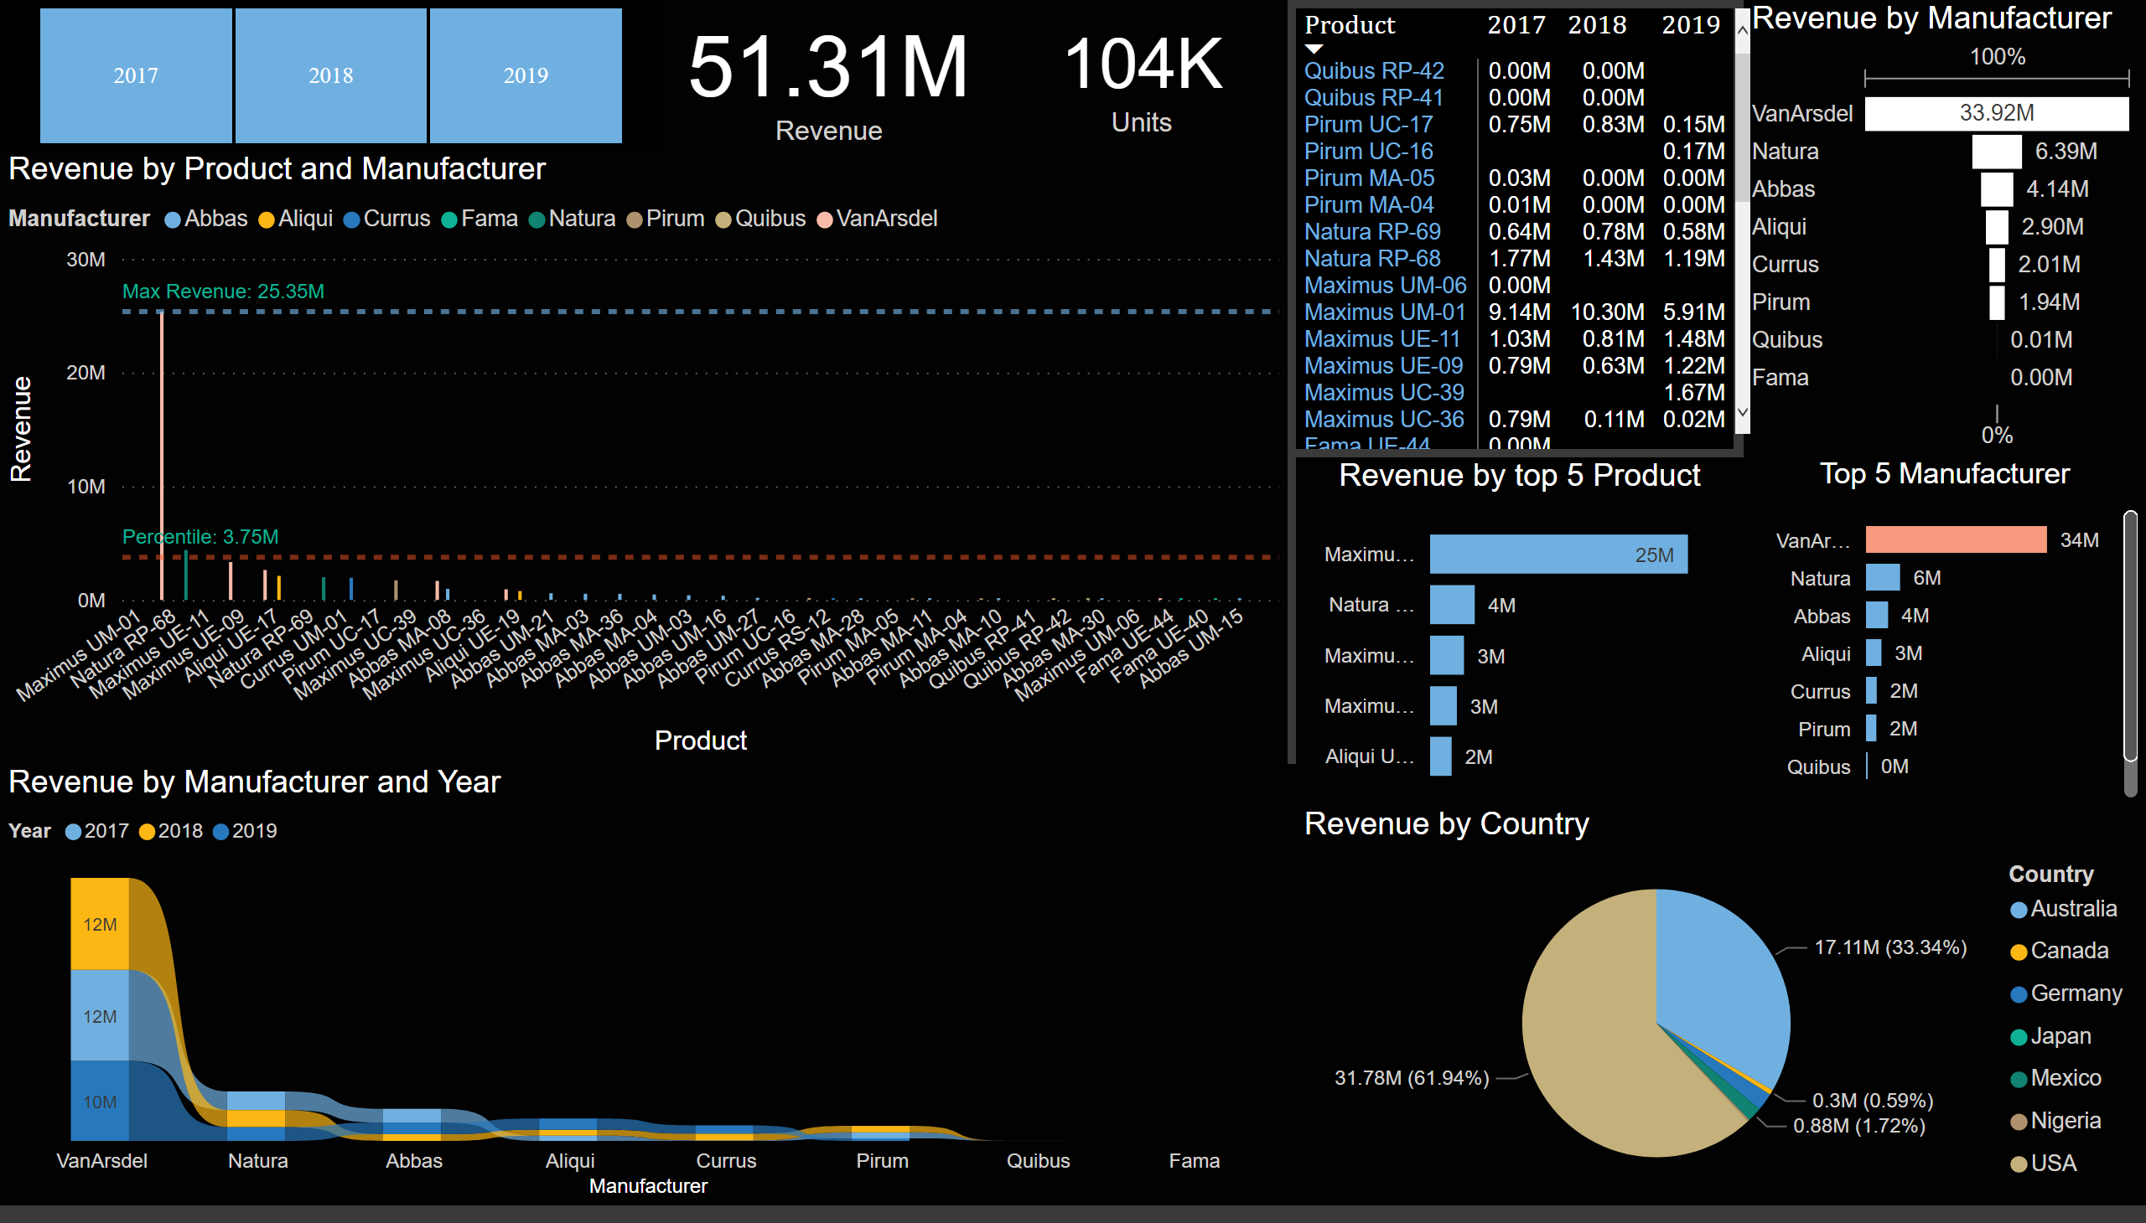
Revenue Details Home
Revenue details of the company
Notes:
﻿2017 had the highest total Revenue at 17,480,350.21, followed by 2018 at 17,399,314.98 and 2019 at 16,428,270.04.﻿
﻿﻿VanArsdel in Year 2018 made up 23.11% of Revenue.﻿﻿ ﻿﻿ ﻿
2019 had the highest average Revenue at 2,738,045.01, followed by 2018 at 2,485,616.43 and 2017 at 2,185,043.78.﻿﻿
﻿﻿At 25,350,698.17, Maximus UM-01 had the highest Revenue and was 1,097.97% higher than Aliqui UE-17, which had the lowest Revenue at 2,116,142.94.﻿﻿
﻿﻿Maximus UM-01 accounted for 67.03% of Revenue.﻿﻿ ﻿﻿ ﻿﻿Across all 5 Product, Revenue ranged from 2,116,142.94 to 25,350,698.17.﻿﻿ ﻿

Slide 4
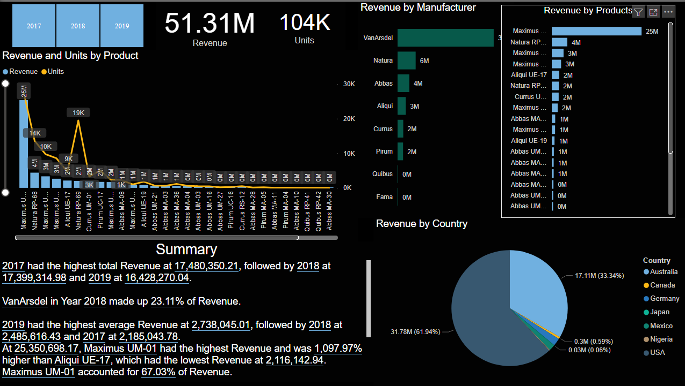
Revenue Details Summary
Notes:
Overall Revenue is currently at 51307935.23. Revenue for Manufacturer VanArsdel and other segments are significantly higher than others.
At 33919710.79, Revenue for Manufacturer VanArsdel is unusually high.
Revenue for Product Maximus UM-01 was unusually high (25350698.169999998), which may have lifted Revenue for Manufacturer VanArsdel.
Revenue for ProductID 396 was unusually high (25350698.169999998), which may have lifted Revenue for Manufacturer VanArsdel.
Revenue for Product Maximus UM-01 was unusually high (25350698.169999998), which may have lifted Revenue for Segment Moderation.
At 31782435.72, Revenue for Country USA is unusually high.
Revenue for Manufacturer VanArsdel was unusually high (19424738.760000046), which may have lifted Revenue for Country USA.
Overall Units is currently at 104294, and Units for Manufacturer VanArsdel and Country USA are significantly higher than other segments at 49099 and 60944, respectively.
At 49099, Units for Manufacturer VanArsdel is unusually high.
Units for Product Maximus UM-01 was unusually high (27492), which may have lifted Units for Manufacturer VanArsdel.
Units for ProductID 396 was unusually high (27492), which may have lifted Units for Manufacturer VanArsdel.

Slide 5
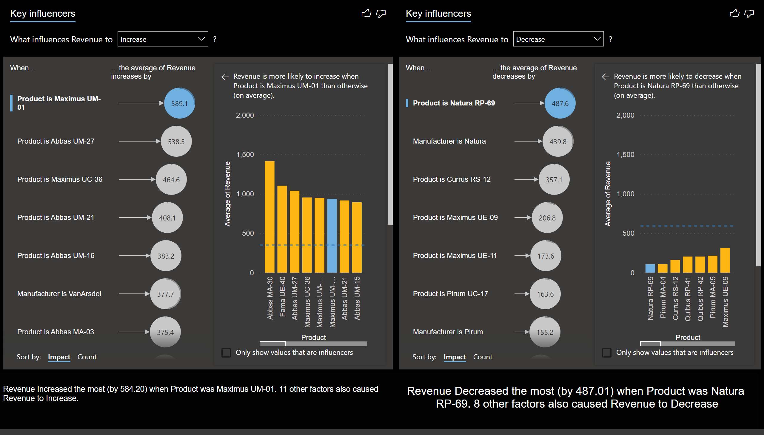
Factors infulences Revenue
Notes:
﻿2017 had the highest total Revenue at 17,480,350.21, followed by 2018 at 17,399,314.98 and 2019 at 16,428,270.04.﻿﻿ ﻿﻿ ﻿﻿VanArsdel in Year 2018 made up 23.11% of Revenue.﻿﻿ ﻿﻿ ﻿﻿2019 had the highest average Revenue at 2,738,045.01, followed by 2018 at 2,485,616.43 and 2017 at 2,185,043.78.﻿﻿ ﻿﻿ ﻿﻿ ﻿﻿At 25,350,698.17, Maximus UM-01 had the highest Revenue and was 1,097.97% higher than Aliqui UE-17, which had the lowest Revenue at 2,116,142.94.﻿﻿ ﻿﻿ ﻿﻿ ﻿﻿Maximus UM-01 accounted for 67.03% of Revenue.﻿﻿ ﻿﻿ ﻿﻿Across all 5 Product, Revenue ranged from 2,116,142.94 to 25,350,698.17.﻿﻿ ﻿

Slide 6
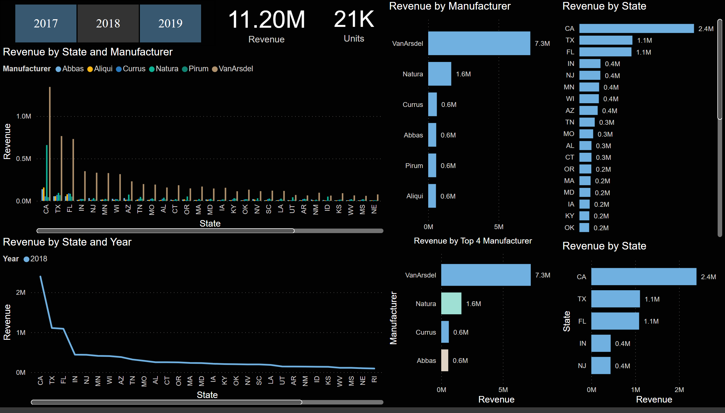
USA Revenue Details

Slide 7
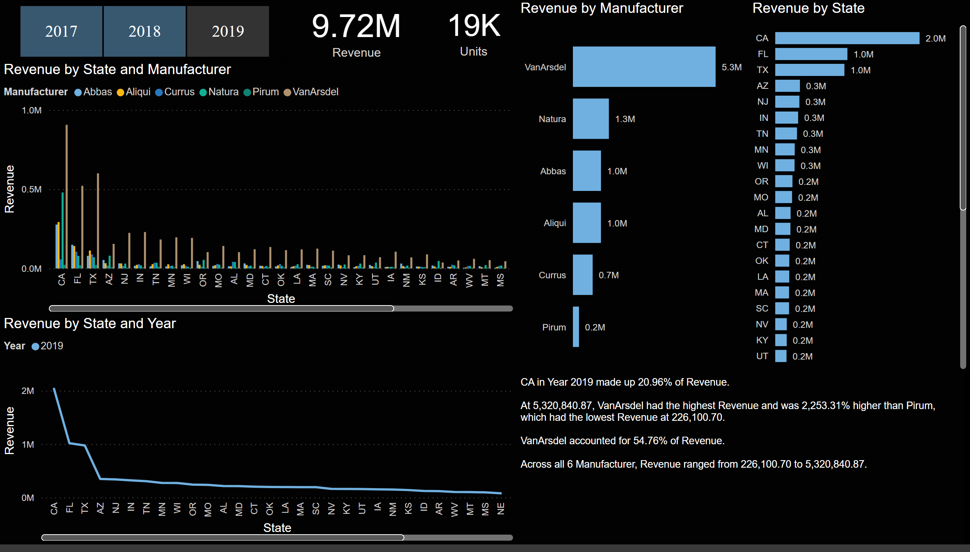
Summary of USA Revenue Details
Notes:
﻿[]﻿﻿ ﻿﻿ ﻿﻿CA in Year 2018 made up 21.40% of Revenue.﻿﻿
﻿﻿﻿﻿[]﻿﻿ ﻿﻿ ﻿﻿[]﻿﻿ ﻿﻿ ﻿﻿At 7,258,981.80, VanArsdel had the highest Revenue and was 1,216.59% higher than Aliqui, which had the lowest Revenue at 551,347.91.﻿﻿ ﻿﻿
﻿﻿[]﻿﻿ ﻿﻿ ﻿﻿VanArsdel accounted for 64.81% of Revenue.﻿﻿ ﻿﻿ ﻿﻿Across all 6 Manufacturer, Revenue ranged from 551,347.91 to 7,258,981.80.﻿﻿ ﻿
﻿

Slide 8
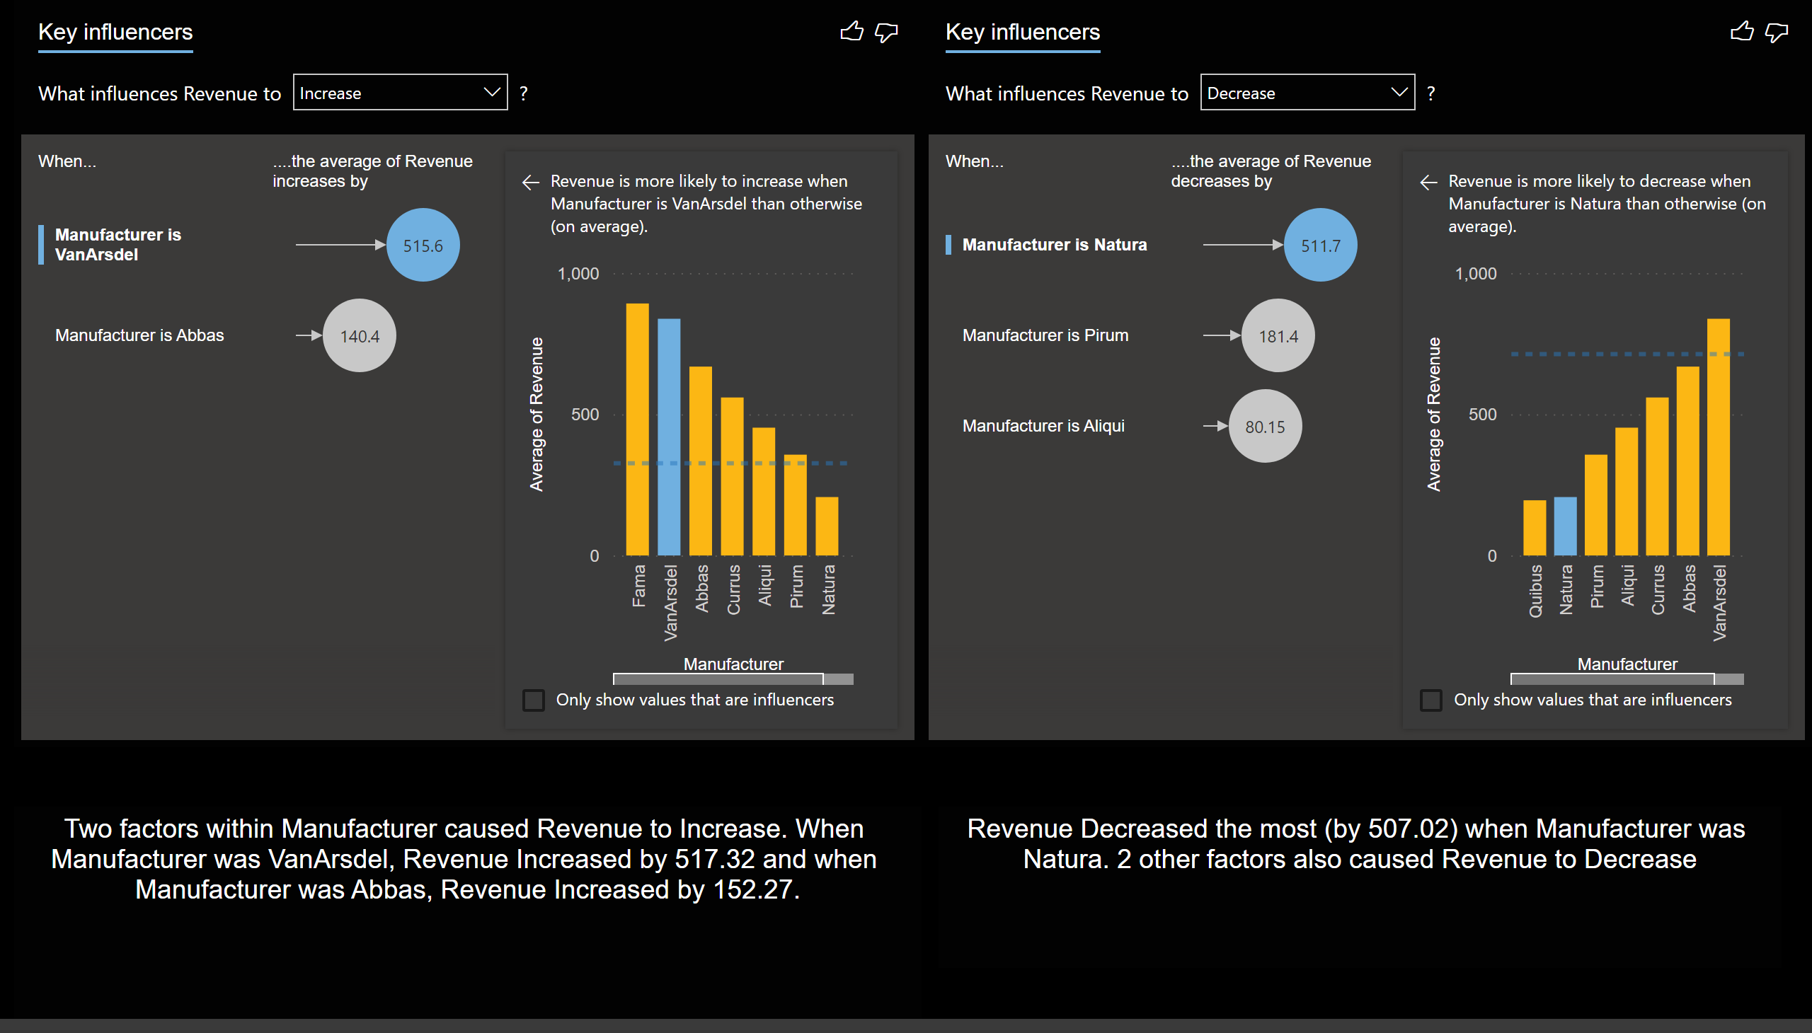
USA Revenue Insights
Notes:
Overall Revenue is currently at 11200824.76, and Revenue for Manufacturer VanArsdel and Segment Moderation are significantly higher than other segments at 7258981.8 and 7898558.75, respectively.
At 7258981.8, Revenue for Manufacturer VanArsdel is unusually high.
At 7258981.8, Revenue for Manufacturer VanArsdel is unusually high.

